Slide 1
Webinar 26 April 2022
Soren Liborius
Topics:
EU decision on sanctions against RT (Russia Today) / Sputnik
What is RT / Sputnik? - in their own words
Russian military doctrine – the Gerasimov doctrine and modern information warfare

Slide 2
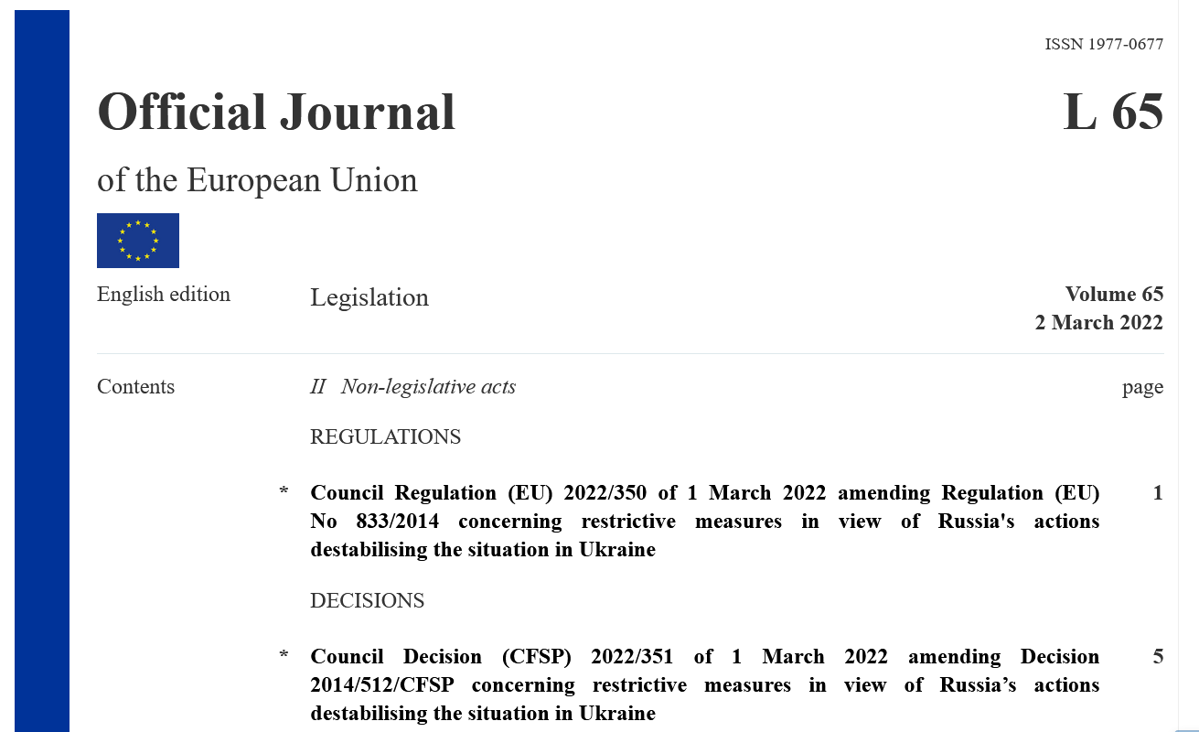
EU Restrictive Measures (sanctions) on RT / Sputnik
Prohibits broadcast and transmission, suspend licences for
RT Russia Today English, UK, Germany, France, Spanish, Sputnik
For the duration of the aggression against Ukraine

Slide 3
RESTRICTIONS AGAINST DISINFORMATION

Slide 4
GOOD TO KNOW ABOUT
PRO-KREMLIN DISINFORMATION MACHINE
RT & SPUTNIK

Slide 6
RT is needed “for about the same reason as why the country needs a Defense Ministry”
RT is capable of “conducting information war against the whole Western world,” using “the information weapon”
RT’s strategic aim is to “conquer” and to “grow an audience” in order to make use of access to this audience in
“critical moments”
Censorship and political control in Russia is good and necessary. We should be like China.
MARGARITA SIMONYAN
Editor-in-chief of the Russian state-controlled media organisations RT and Rossiya Segodnya

Slide 7
“The period of impartial journalism is over. Objectivity is a myth”
DMITRY KISELYOV
TV host. Known as "Putin's mouthpiece“. Head of Rossiya Segodnya

Slide 8
RT AND SPUTNIK:
AUDIENCE REACH & RESOURCES
RT has a large online audience. It had 4.6 million subscribers on YouTube and 7.4 million followers on Facebook in Feb 2022.
According to RT as of March 2022, the network's feed is carried by 22 satellites and over 230 operators, providing a distribution reach to about 700 million households in more than 100 countries.
23 billion roubles or €325 million at the time, were designated for RT in the Russian federal budget draft for 2020. In 2019, RT announced on its Telegram channel that RT and Rossiya Segodnya’s budget from federal funding was $440 million.

Slide 9
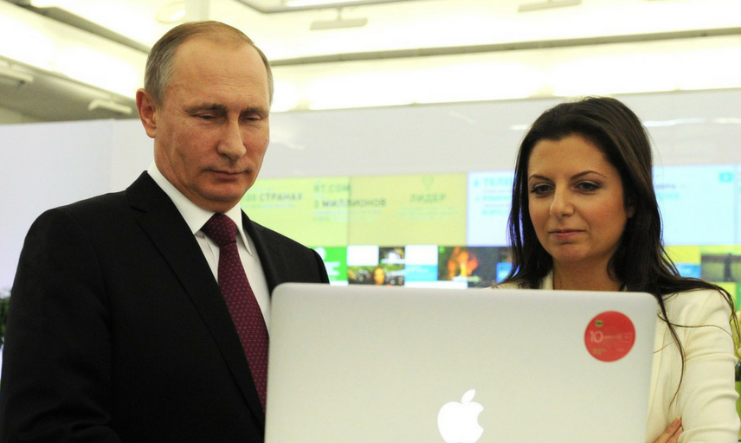
CLOSE TIES WITH THE KREMLIN
RT’s chief editor Margarita Simonyan with President Putin at the celebration of RT’s 10th anniversary in December 2015

Slide 10
HOW RT & SPUTNIK COVER WAR IN UKRAINE
Sputnik in English:
Neo-Nazis are part of political mainstream in Ukraine
RT Arabic:
THE NAZI IDEOLOGY IS EVIDENT IN UKRAINIAN SCHOOLS
Sputnik armenia:
THE PURPOSE OF THE OPERATION IN UKRAINE IS TO SAVE PEOPLE FROM GENOCIDE
Sputnik in Spanish:
THE IMAGES OF DEAD BODIES IN BUCHA MAY BE A DIVERSION OF ATTENTION FROM US BIOLABS IN UKRAINE
Sputnik Armenia:
Ukraine was preparing to attack Belarus
Sputnik in English:
Russian troops pose no threat to Ukrainian civilians

Slide 11
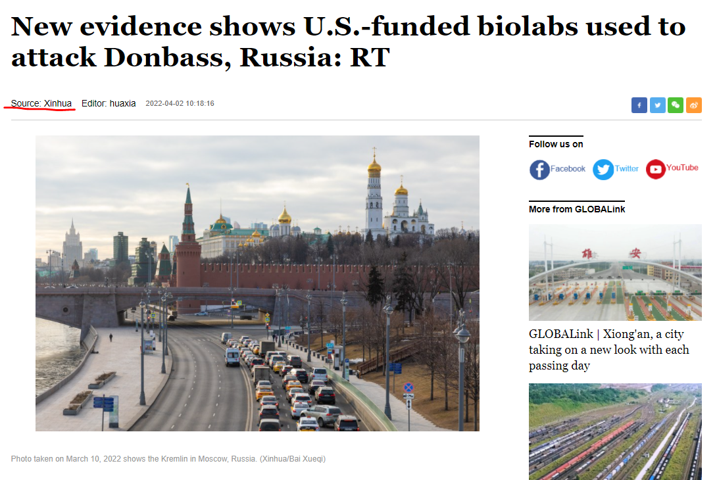
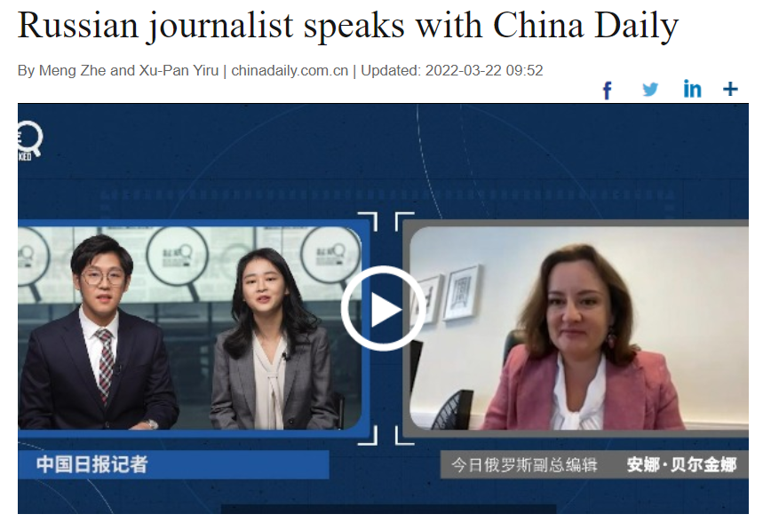
DISINFORMATION IN CHINESE MEDIA
Anna Belkina, deputy editor-in-chief at Russia Today

Slide 12
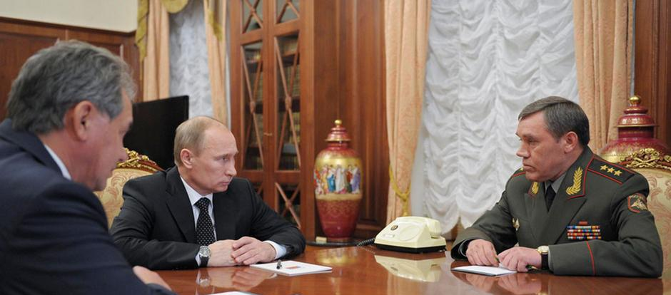
GERASIMOV DOCTRINE
The next conflict will take place in all domains, land/sea/air/ space/ cyber/ economic field/ the cognitive domain.
Russia needs to mobilise all the forces across all domains.
Russia needs to control the information space in a conflict. If not, our opponents will, and they will use it against us.
GEN. VALERY GERASIMOV
Chief of the Russian General Staff

Slide 13
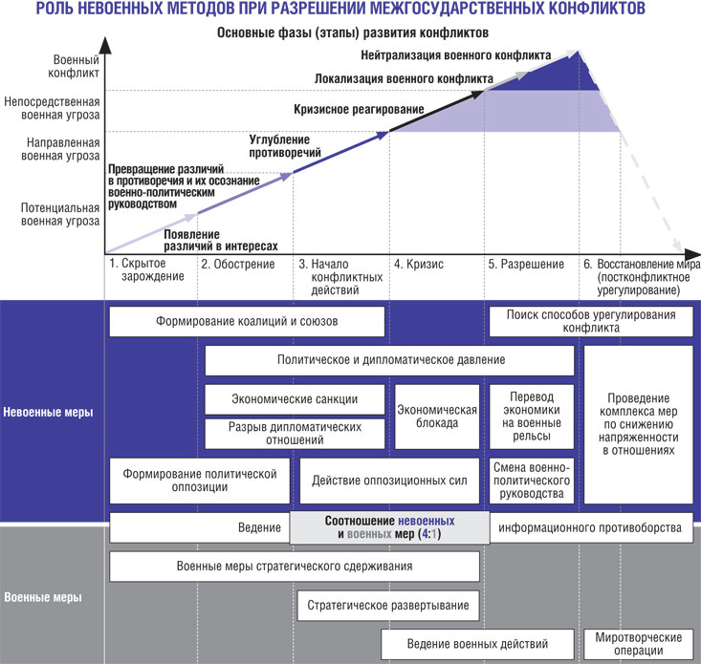
https://vpk-news.ru/articles/14632

Slide 15
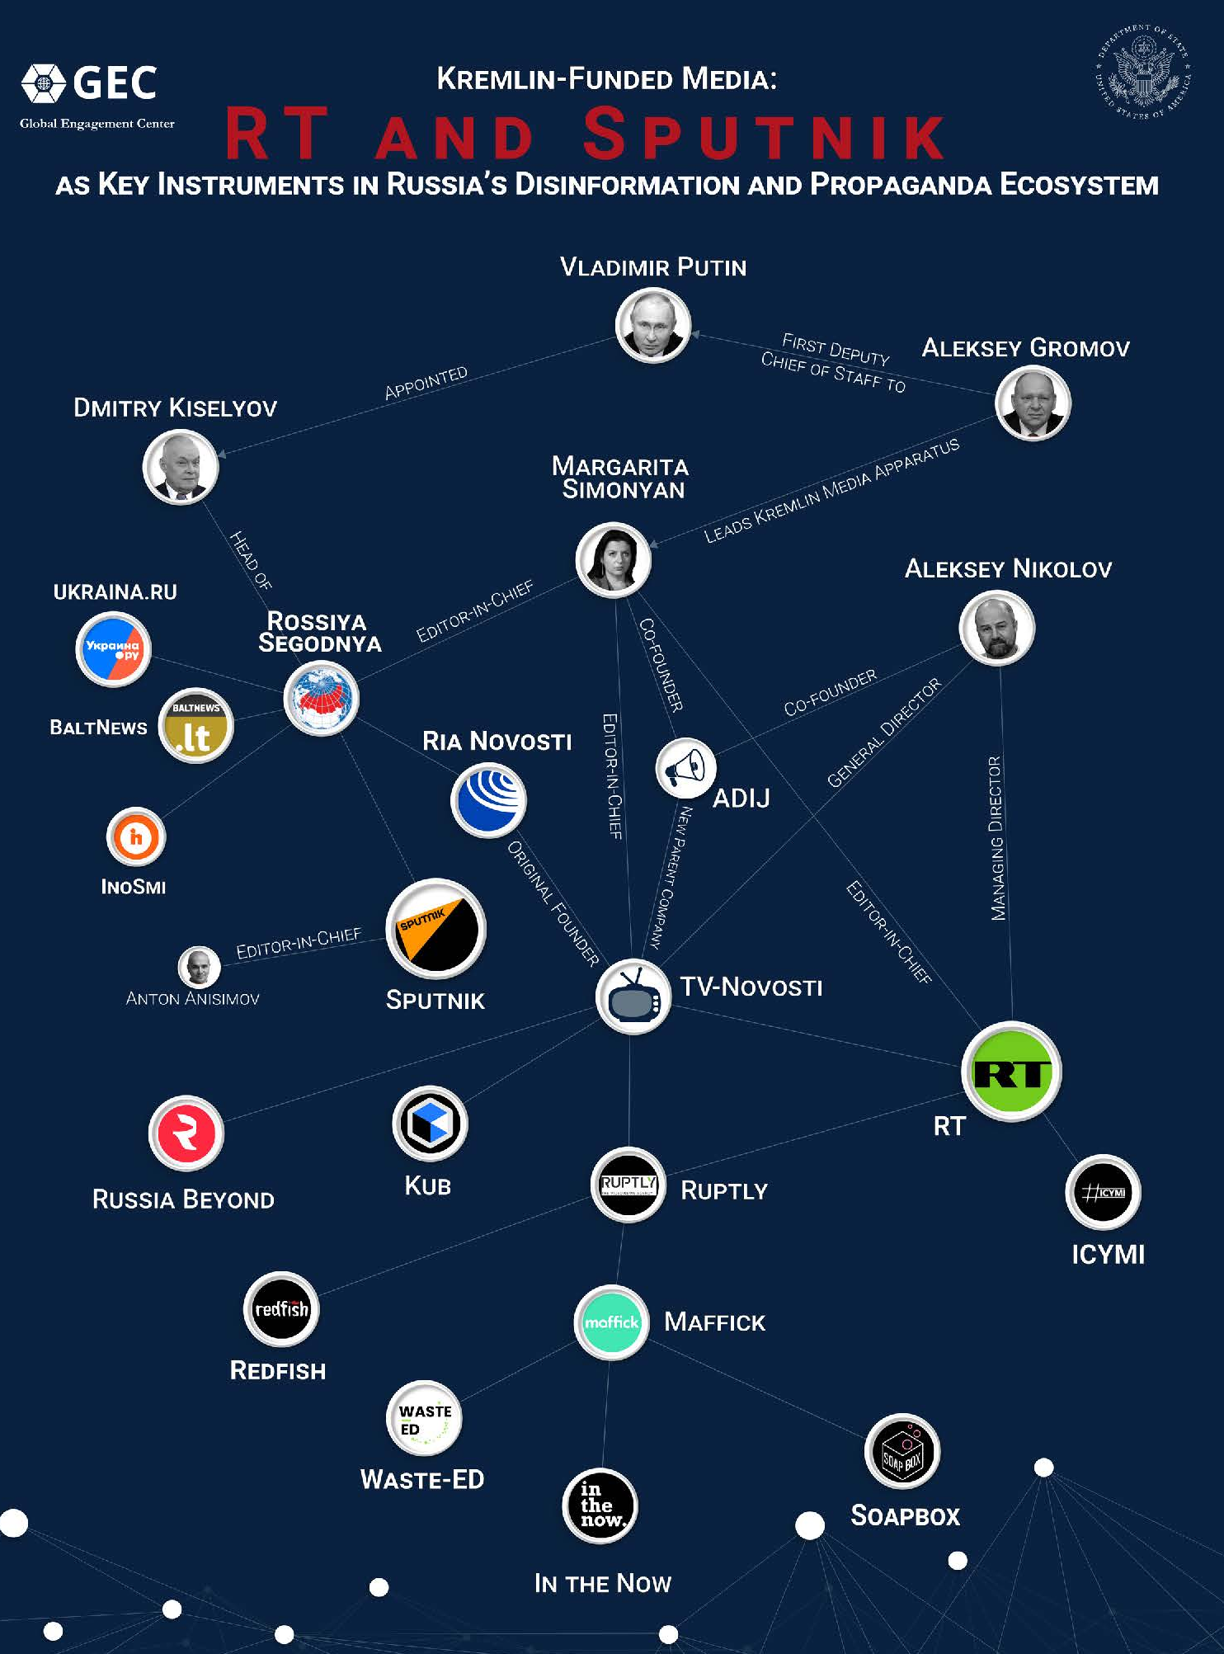
ALEXEY GROMOV
First Deputy Chief of Staff of the Presidential Administration of Russia: Oversees production of state media & propaganda in Russia.
DMITRY KISELYOV
Known as "Putin's mouthpiece“. Appointed by Vladimir Putin to head Rossiya Segodnya.
MARGARITA SIMONYAN
Editor-in-chief of the Russian state-controlled media organisation RT (Russia Today)

Slide 16
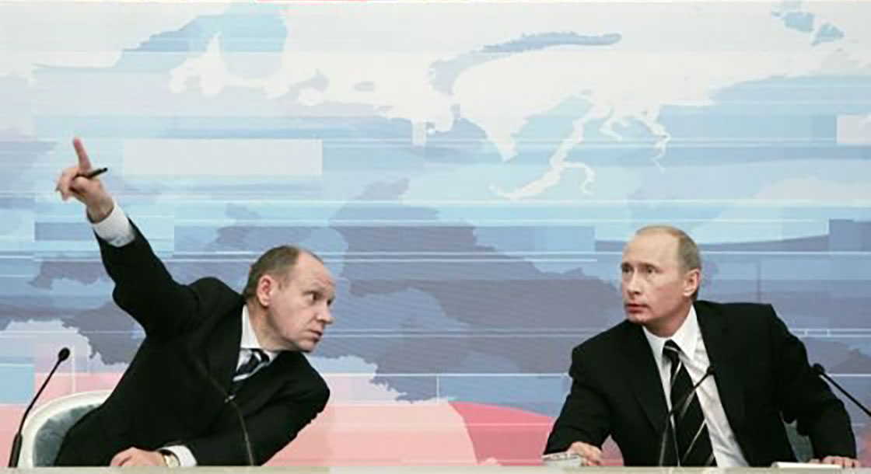
ALEXEY GROMOV
First Deputy Chief of Staff of the Presidential Administration
The heads of television channels usually attend weekly meetings at the presidential administration in Moscow, where they are told what must be broadcast and what is to be suppressed/played down
Since 04 March 2022: Censorship laws in Russia

Slide 18
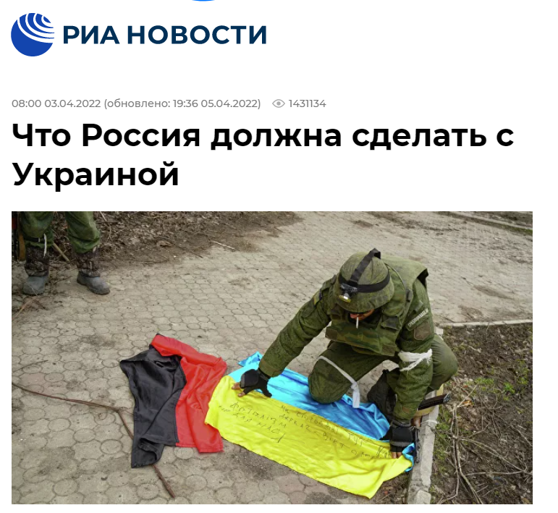
RIA OP-ED ARTICLE:
“WHAT SHOULD RUSSIA DO WITH UKRAINE?” 03 April 2022
The terms “Nazis” and “Nazism” are used excessively in the article to brand anything associated with the Ukrainian state, the Kyiv government, or the Ukrainian authorities.
THE PLAN IS TO:
– destroy on the battlefield all the “Nazis” who took up arms;
– liquidate part of the Ukrainians by carrying out mass repression;
– liquidate and ban all Ukrainian armed formations and all organisations associated with the practice of “Nazism”;
– give privileges to those waiting for the Russian authority;
– introduce Russian laws and Russian courts to ban language and culture;
– introduce strict censorship, destroy textbooks and, in general, everything Ukrainian;
– ban even the name Ukraine and the term Ukrainian itself;
– do all this by force and with the support of (military) power from Russia.
TIMOFEY SERGEYTSEV
Political philosopher & film director

Slide 19
EU Restrictive Measures (sanctions) on RT / Sputnik

Slide 20
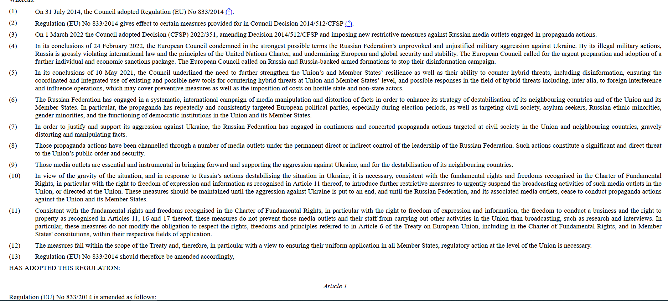

Slide 21
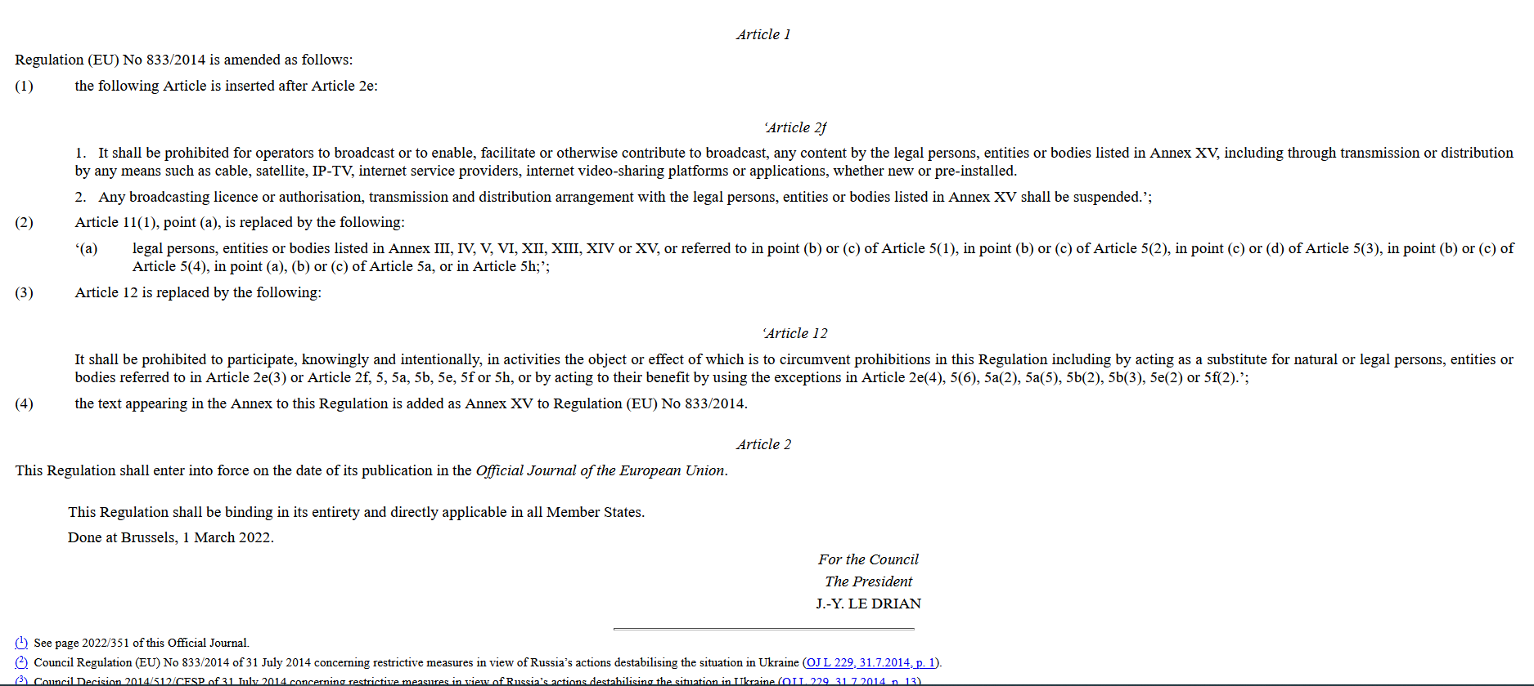

Slide 22
Resources
EUvsDisinfo www.EUvsDisinfo.eu
https://euvsdisinfo.eu/the-kremlins-weapons-of-deception-7-things-you-need-to-know-about-rt-sputnik/
European Council Press Release https://www.consilium.europa.eu/en/press/press-releases/2022/03/02/eu-imposes-sanctions-on-state-owned-outlets-rt-russia-today-and-sputnik-s-broadcasting-in-the-eu/
Official Journal of the European Union: https://eur-lex.europa.eu/legal-content/EN/TXT/?uri=uriserv%3AOJ.L_.2022.065.01.0001.01.ENG&toc=OJ%3AL%3A2022%3A065%3AFULL
Tribunal de l’Union Europeenne - EU Curia https://curia.europa.eu/jcms/upload/docs/application/pdf/2022-03/cp220054fr.pdf?fbclid=IwAR2ueibAMz0Y3gwOyNXmydmxy0veWzdhSQc-aCoa90IkYfPpW81bcxief9o

Slide 23
FOR MORE INFORMATION VISIT
EUVSDISINFO.EU
Follow us on:
Subscribe:
Twitter: @EUvsDisinfo
euvsdisinfo.eu/subscribe
Facebook: EUvsDisinfo
LinkedIn: EUvsDisinfo

